Slide 1
Chapter 2
Recognizing Opportunities and Generating Ideas
Bruce R. Barringer
R. Duane Ireland

Slide 2
Chapter Objectives
1 of 3
Explain why it’s important to start a new firm when its “window of opportunity” is open.
Explain the difference between an opportunity and an idea.
Describe the three general approaches entrepreneurs use to identify opportunities.
Identify the four environmental trends that are most instrumental in creating business opportunities.
List the personal characteristics that make some people better at recognizing business opportunities than others.

Slide 3
Chapter Objectives
2 of 2
Identify the five steps in the creative process.
Describe the purpose of brainstorming and its use as an idea generator.
Describe how to use library and Internet research to generate new business ideas.
Explain the purpose of maintaining an idea bank.
Describe three steps for protecting ideas from being lost or stolen.

Slide 4
What is An Opportunity?
1 of 2
Two ways: Externally stimulated(decides to launch, searches, recognizes
an opportunity, starts a business).
Internally stimulated(recognizes a problem or an opportunity gap, creates a business to fill it).
An opportunity is a favorable set of circumstances that creates a need for a new product, service or business.

Slide 5
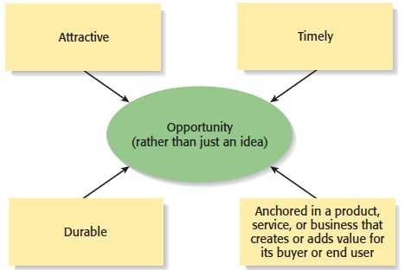
What is an Opportunity?
2 of 2
An opportunity has four essential qualities

Slide 6
Window Of Opportunity
Metaphor describing the time period in which a firm can realistically enter a new market.
Once the market for a new product is established, its window of opportunity opens. As the market grows, firms enter and try to establish a profitable position. At some point, the market matures, and the window of opportunity closes.
Yahoo! The first search engine

Slide 7
Idea
An idea is a thought, an impression, or a notion.
An idea may or may not meet the criteria of an opportunity.

Slide 8

Three Ways to Identify an Opportunity

Slide 9
First Approach: Observing Trends
1 of 2
Observing Trends
Trends create opportunities for entrepreneurs to pursue.
The most important trends are:
Economic trends.
Social trends.
Technological advances.
Political action and regulatory changes.
It’s important to be aware of changes in these areas.

Slide 10
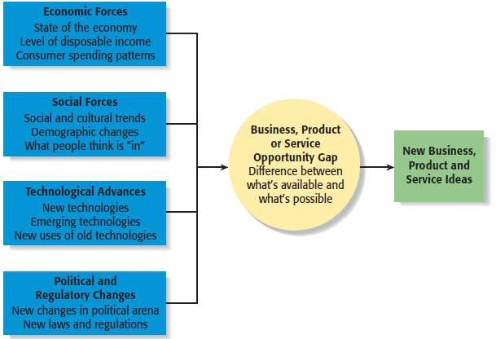
First Approach: Observing Trends
2 of 2
Environmental Trends Suggesting Business or Product Opportunity Gaps

Slide 11
Trend 1: Economic Forces
Example of Economic Trend Creating a Favorable Opportunity
A weak economy favors startups that help consumers save money.
Economic trends help determine areas that are ripe for new startups and areas that startups should avoid.

Slide 12
Trend 2: Social Forces
Examples of Social Trends
Increasing interest in social networks such as Fb, Twitter.
Increasing focus on health,
fitness, and wellness.
Proliferation of mobile phones and mobile phone apps.
Emphasis on clean forms of energy.
Increasing interest in healthy and “green” foods.
New forms of music and other
types of entertainment.
Social trends show how people and businesses behave and set their priorities. These trends provide opportunities for new businesses to accommodate the changes.

Slide 13
Trend 3: Technological Advances
1 of 2
Examples of Entire Industries that Have Been Created as the Results of Technological Advances
Computer industry
Internet
Digital photography
Advances in technology frequently create business opportunities.

Slide 14
Trend 3: Technological Advances
2 of 2
Example:
The creation of the Apple iPod, iPhone, iPad and similar devices has in turned spawned entire industries that produce compatible devices.
Once a technology is created, products often emerge to advance it.

Slide 15
Trend 4: Political Action and Regulatory Changes
1 of 2
General Example
Laws to protect the environment have created opportunities for entrepreneurs to start firms that help other firms comply with environmental laws and regulations.
Global political instability and the threat of terrorism have resulted in many firms becoming more security conscious.
Political action and regulatory changes also provide the basis for opportunities.

Slide 16
Trend 4: Political Action and Regulatory Changes
2 of 2
Company created to help other companies comply with a specific law.

Slide 17
Second Approach: Solving a Problem
1 of 2
Solving a Problem
Sometimes identifying opportunities simply involves noticing a problem and finding a way to solve it.
These problems can be pinpointed through observing trends, observing the challenges that people encounter in their daily lives and through more simple means, such as intuition, or change.

Slide 18

Second Approach: Solving a Problem
2 of 2
A problem facing the U.S. and other countries is finding alternatives to fossil fuels.
A large number of
entrepreneurial firms, like this wind farm, are being
launched to solve this problem.
Among the potential solutions is solar-generated power.

Slide 19
Third Approach: Finding Gaps in the Marketplace
1 of 2
Gaps in the Marketplace
A third approach to identifying opportunities is to find a gap in the marketplace
A gap in the marketplace is often created when a product or service is needed by a specific group of people but doesn’t represent a large enough market to be of interest to mainstream retailers or manufacturers.

Slide 20
Third Approach: Finding Gaps in the Marketplace
2 of 2
Specific Example
Tish Cirovolv realized there were no guitars on the market made specifically for women. To fill this gap, she started Daisy Rock Guitars, a company that makes guitars just for women.
Product gaps in the marketplace represent potentially viable business opportunities.

Slide 21
Personal Characteristics of the Entrepreneur
Characteristics that tend to make some people better at recognizing opportunities than others
Prior Experience
Cognitive Factors
Social Networks
Creativity

Slide 22
Prior Experience
Prior Industry Experience
Several studies have shown that prior experience in an industry helps an entrepreneur recognize business opportunities.
By working in an industry, an individual may spot a market niche that is underserved.
It is also possible that by working in an industry, an individual builds a network of social contacts who provide insights that lead to recognizing new opportunities.

Slide 23
Corridor Principle
States that once an entrepreneur starts a firm, he or she begins a journey down a path where “corridors” leading to new venture opportunities become apparent.

Slide 24
Cognitive Factors
Cognitive Factors
Studies have shown that opportunity recognition may be an (inborn)natural skill or cognitive process.
Some people believe that entrepreneurs have a “sixth sense” that allows them to see opportunities that others miss.
This “sixth sense” is called entrepreneurial alertness, which is formally defined as the ability to notice things without engaging in deliberate search.

Slide 25
Social Networks
1 of 3
Social Networks
The extent and depth of an individual’s social network affects opportunity recognition.
People who build a substantial network of social and professional contacts will be exposed to more opportunities and ideas than people with limited networks.
In one survey of 65 start-ups, half the founders reported that they got their business idea through social contacts.
-Strong Tie Vs. Weak Tie Relationships
Relationships with other people are called “ties.” (See next slide.)

Slide 26
Social Networks
2 of 3
Nature of Strong-Tie Vs. Weak Tie Relationships
Strong-tie relationship are characterized by frequent interaction and form between coworkers, friends, and spouses.
Weak-tie relationships are characterized by infrequent interaction and form between casual acquaintances.
Result
It is more likely that an entrepreneur will get new business ideas through weak-tie rather than strong-tie relationships. (See next slide.)

Slide 27
Social Networks
3 of 3
Why weak-tie relationships lead to more new business ideas than strong-tie relationships
Strong-Tie Relationships Weak-Tie Relationships
These relationships, which typically form between like minded individuals, tend to reinforce insights and ideas that people already have.
These relationships, which form between casual acquaintances, are not as apt to be between like- minded individuals, so one person may say something to another that sparks a completely new idea.

Slide 28
Creativity
1 of 2
Creativity
Creativity is the process of generating a novel or useful idea.
Opportunity recognition may be, at least in part, a creative process.
For an individual, the creative process can be broken down into five stages.

Slide 29
Difference Between Creativity and Innovation
Creativity:
Creativity is the process of generating a novel or useful idea but does not require implementation.
Innovation:
Innovation refers to the successful introduction of new
outcomes by a firm.

Slide 30
Difference between Invention and Innovation
Invention:
Invention----The creation of something new-----Result in new knowledge.
Innovation:
Innovation---- the transformation of an idea or resources into useful information----Result in new product or service.

Slide 31
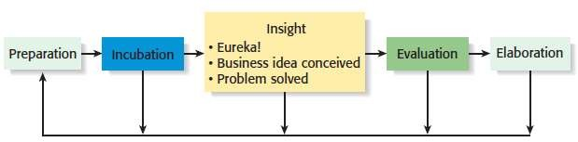
Creativity
2 of 2
Five-Steps to Generating Creative Ideas

Slide 32
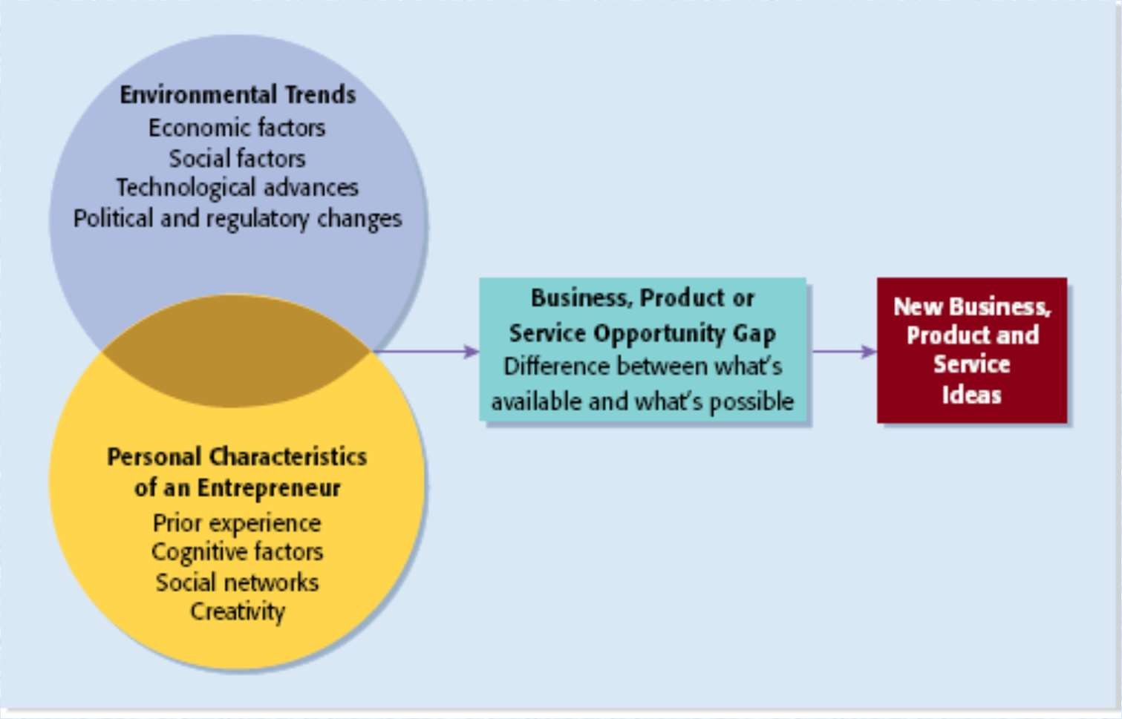
Full View of the Opportunity Recognition
Process
Depicts the connection between an awareness of emerging trends and the personal characteristics of the entrepreneur

Slide 33
Techniques For Generating Ideas
Brainstorming
Focus Groups
Library and Internet Research

Slide 34
Brainstorming
Brainstorming
Is a technique used to generate a large number of ideas and solutions to problems quickly.
A brainstorming “session” typically involves a group of people, and should be targeted to a specific topic.
Rules for a brainstorming session:
No criticism.
Freewhelling is encouraged.
The session should move quickly.
Leapfrogging is encouraged.

Slide 35
Focus Groups
Focus Group
A focus group is a gathering of five to ten people, who have been selected based on their common characteristics relative to the issues being discussed.
Focus groups are conducted by trained moderators, who uses the internal dynamics of the group environment to gain insight into why people feel the way they do about a particular issue.
Although focus groups are used for a variety of purposes, they can be used to help generate new business ideas.

Slide 36
Library and Internet Research
1 of 3
Library Research
Libraries are an often underutilized source of information for generating new business ideas.
The best approach is to talk to a reference librarian, who can point out useful resources, such as industry-specific magazines, trade journals, and industry reports.
Simply browsing through several issues of a trade journal or an industry report on a topic can spark new ideas.

Slide 37
Libraries and Internet Research
2 of 3
Large public and university libraries typically have access to powerful search engines and industry reports that would cost thousands of dollars to access on your own.
An example is IBIS World (www.ibisworld.com), a company that publishes market research on all major industries and subcategories within industries.

Slide 38
Library and Internet Research
3 of 3
Internet Research
If you are starting from scratch, simply typing “new business ideas” into a search engine will produce links to newspapers and magazine articles about the “hottest” new business ideas.
If you have a specific topic in mind, setting up Google or Yahoo! e-mail alerts will provide you to links to a constant stream of newspaper articles, blog posts, and news releases about the topic.
Targeted searches are also useful.

Slide 39
Another approach is to follow business leaders and experts in the industries you’re interested in on
Twitter.
The best way to locate people on Twitter you might be interested in following is by typing into the search bar labeled “Who to Follow” relevant keywords preceded by the “#” sign.
For example, if you’re interested in solar power, type “#solarpower” into the search bar. All the results will be people or companies who tweet about solar power topics.

Slide 40
Other Techniques
Customer Advisory Boards
Some companies set up customer advisory boards that meet regularly to discuss needs, wants, and problems that may lead to new ideas.
Day-In-The-Life Research
A type of research, where the employees of a company spend a day with a customer.

Slide 41
Encouraging New Ideas
Establishing a Focal Point for Ideas
Some firms meet the challenge of encouraging, collecting, and evaluating ideas by designating a specific person to screen and track them—for if its everybody’s job, it may be no one’s responsibility.
Another approach is to establish an idea bank (or vault), which is a physical or digital repository for storing ideas.
Encouraging Creativity at the Firm Level
Creativity is the raw material that goes into innovation and should be encouraged at the organizational and individual supervisory level.

Slide 42
Protecting Ideas From Being Lost or Stolen
Step 1
The idea should be put in a tangible form such as entered into a physical idea logbook or saved on a computer disk, and the date the idea was first thought of should be entered.
Step 2
The idea should be secured. This may seem like an obvious step, but is often overlooked.
Step 3
Avoid making an inadvertent or voluntary disclosure of an idea, in a manner that forfeits the right to claim exclusive rights to it.

